Slide 1
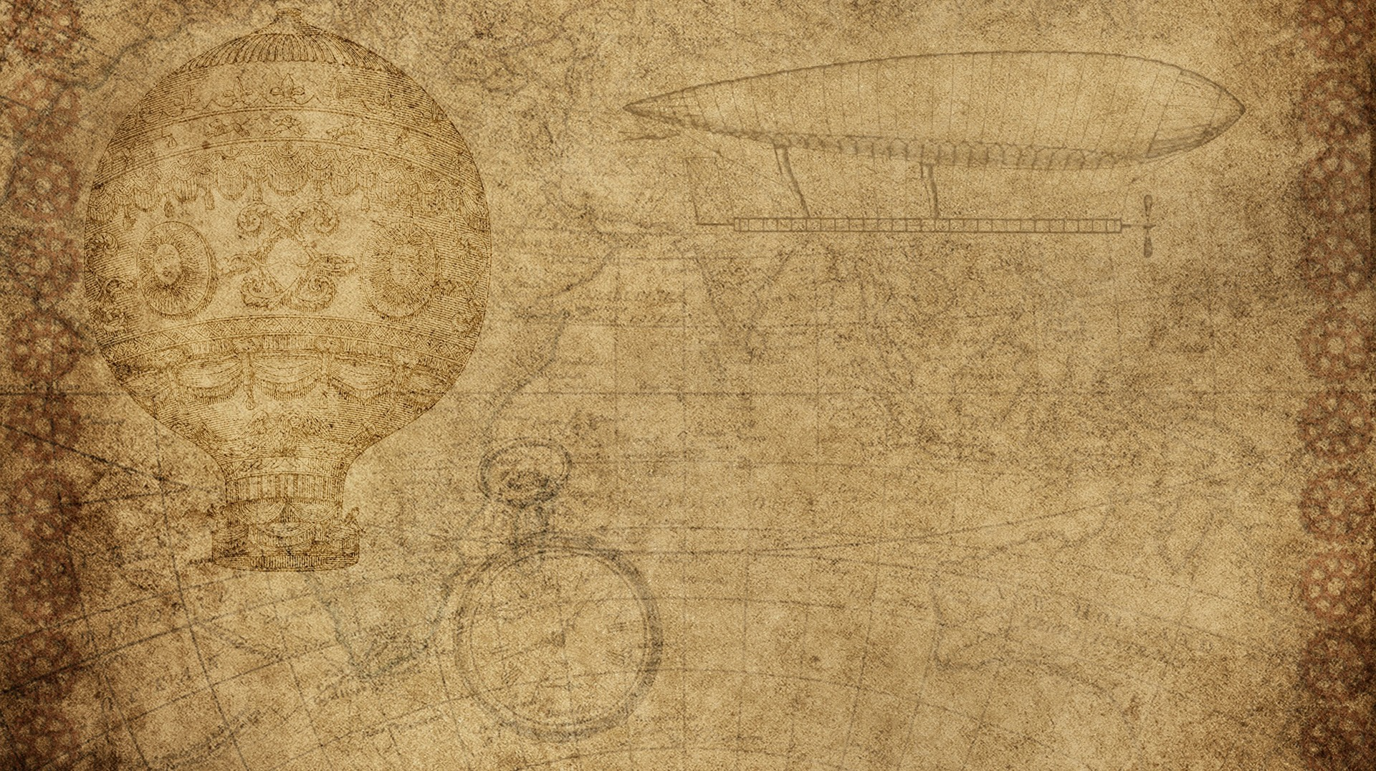

Becoming a Computer Vision DEV.
- Mohd. Asif Data Scientist (CV)

Slide 2

Steps to take:
Learning skills
Making personal projects
Showcasing your work
Entering the field

Slide 3

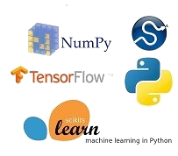

1. Learning skills
Python
Numpy, Matplotlib, Scipy
OpenCV
Pandas, Stats, Sklearn, ML Theory
DL & Computer Vision (Tensorflow / PyTorch)

Slide 4



1. Learning skills (Additional)
Git & Github
Linux
Building APIs
Flask / Sanic
Docker, Cloud
Mediapipe

Slide 5


1I. Making Personal projects
Image processing projects
Color detection, tracking, etc
Face detection / recognition
Object detection / classification
Make applications
Flask, Kivy
Kaggle

Slide 6



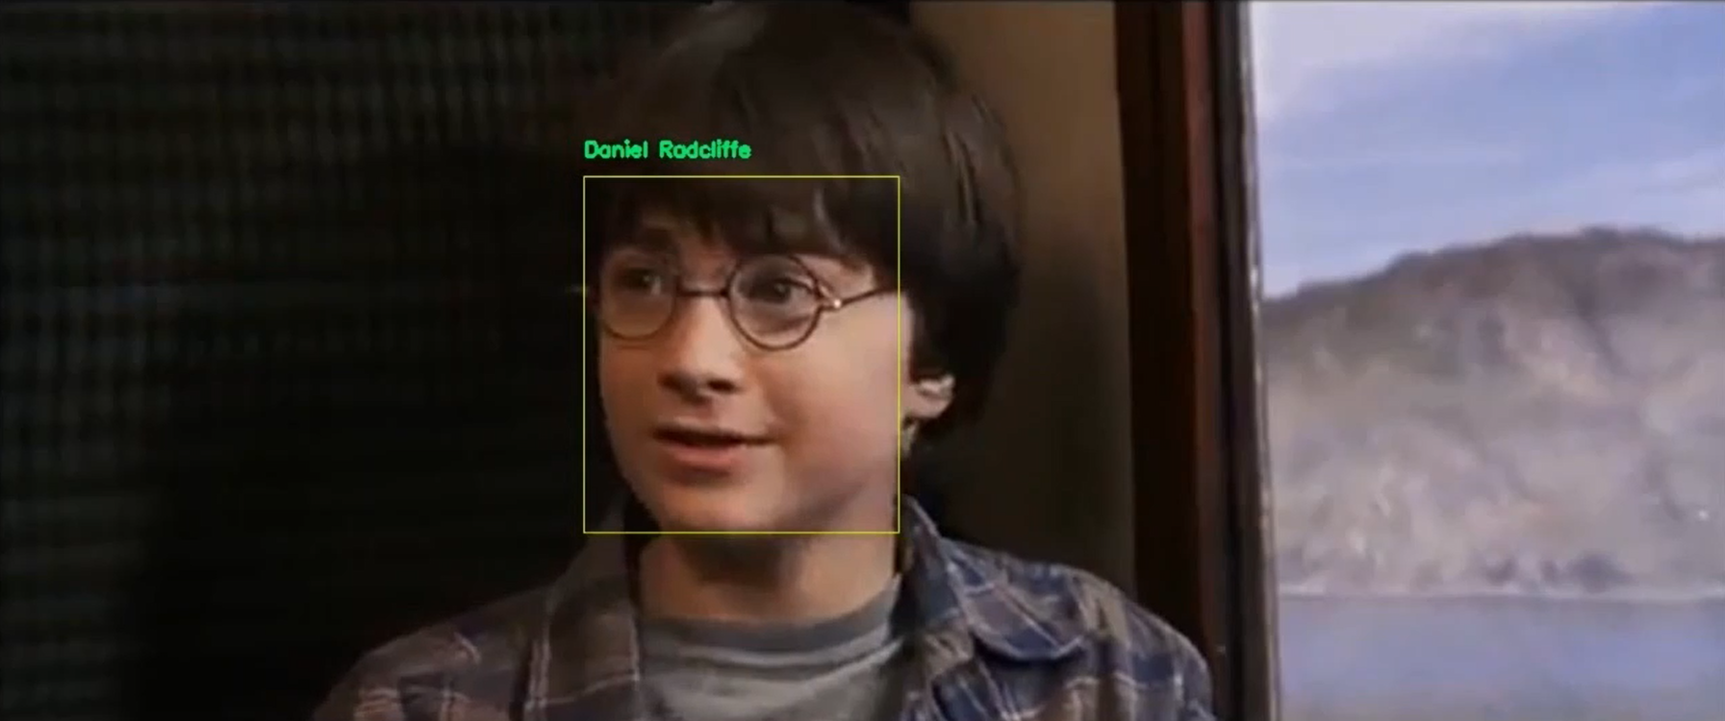
iii. Showcasing your work
Publish on Github / Blogs / YouTube
https://github.com/computervisionpro
Action recognition app with Kivy
Facial recognition
OCR and translation

Slide 7

I v. enter the field
Join groups on LinkedIn / FB / Reddit
Apply for full time jobs, if it isn’t working out then try
Freelancing
Internships

Slide 8

SUBSCRIBE => ComputerVisionPro

